Slide 1
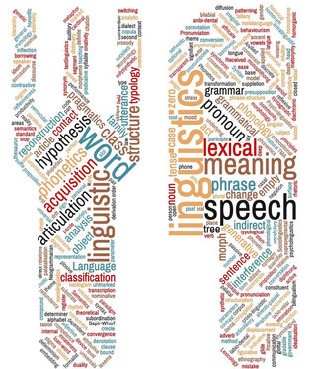
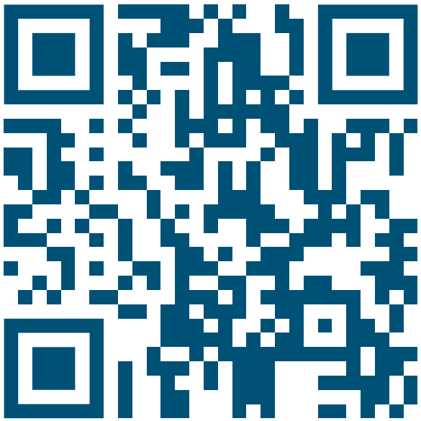
LUNCH & LINGUISTICS
We are happy to invite you to an informal and friendly space for researchers (from advanced Master and PhD students to Post-Docs) where you can present and discuss your work-in-progress projects, as well as network with researchers coming from different linguistics fields!
Lunch & Linguistics is the perfect place to get feedback on your current work, brain storm on new project or even do a dry run for any other presentation in a safe and convivial environment.
Presentations and discussions are preceded by a mindful lunch break together to get to know each other in a relaxed atmosphere.
Lunch & Linguistics will take place during the semester on Wednesdays from 12:30 to 13:30 at Meister-Ekkehart-Str. 7, 2nd floor, right.
SUMMER TERM PROGRAMME – save the date!
16th April – Tabea Thies, Anne Hermes, Philipp Buech
Investigating Speech Breathing with Electromagnetic Articulography
The presenters also offer an introductory workshop to the “Articulatory Data Analysis Tool” (ADA, an open-source tool for the visualization, annotation, and measurement of acoustic and kinematic data) after L&L, from 15:00 to 17:00. If you are interested, please contact: tthies1@uni-koeln.de
4th June– Maria Lialiou CANCELLED
18th June – David Felipe Guerrero-Beltrán (Université de Paris)
Background-Foreground discourse relations and tense marking in Burarra/Gun-nartpa (Maningrida, Australia)
There are still free spots in May this semester!
If you want to use this space as a presenter, write to s.sbranna@uni-koeln.de
We look forward to your contribution!
Kontakt: Simona Sbranna | Tobias-Alexander Herrmann | ccls-info@uni-koeln.de | ccls.phil-fak.uni-koeln.de

